Slide 1
Intro to Experimental Design
OCE2901 – Surf Engineering Analysis

Slide 2

Introduction What research will you pursue?
Let’s take some time to discuss

Slide 3

Scientific Method
The method has been in constant evolution since man has become familiar with rationalized thinking (Ancient Greece)
The process of observing, asking questions, and drawing conclusions through rigorous testing and experimentation
Used to develop theorems that explain empirical observations

Slide 4



Aside: Froude Number
Notes:
Froude Lecture: https://www.rina.org.uk/On_the_Rolling_of_Ships.html

Slide 5
Step One: Research and Questions
Do some research to ask a question and formulate a hypothesis (educated guess) as to its answer
Use existing experience and previous studies to support your hypothesis
Hypotheses typically follow the “if that, then this” format where a changing independent variable drives a resultant dependent variable.
E.g. If storm-generated winds from the Antarctic interact with the equatorial trade winds at the equator, then most of their energy will be dissipated through destructive interference
Discussion: Can you produce a hypothesis for your group based on your research question?

Slide 6
Step Two: Design The Experiment
The experiment must be designed to answer the hypothesis
The independent variable must be isolated
The dependent variable must be precisely and accurately measured
Extraneous, outside variables must also be isolated
Discussion: What is the difference between accuracy and precision?

Slide 7
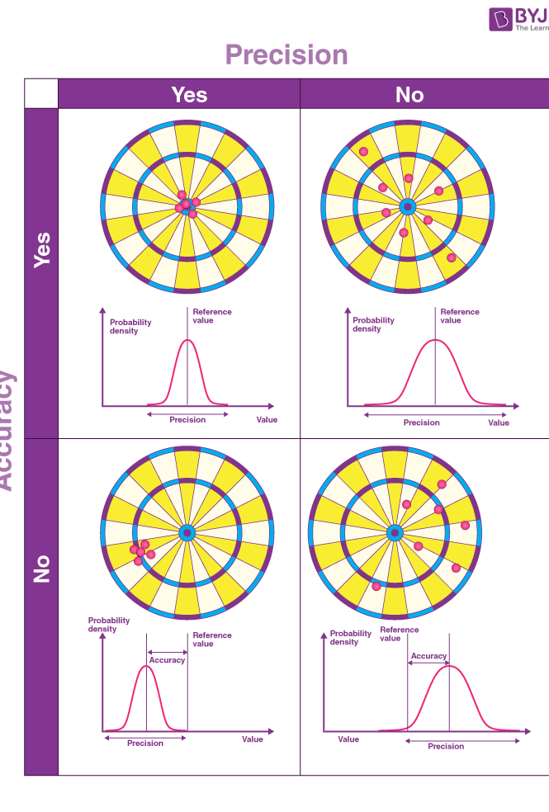
Aside: Accuracy vs Precision
Accuracy
How close your measurements are to the correct value; small error
How close your measurements are to each other; small deviation or variance
Precision

Slide 8
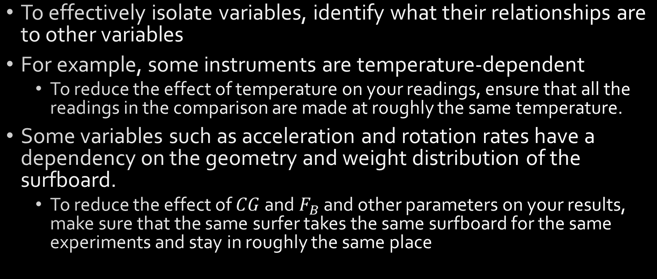
Aside: Isolating Variables
To effectively isolate variables, identify what their relationships are to other variables
For example, some instruments are temperature-dependent
To reduce the effect of temperature on your readings, ensure that all the readings in the comparison are made at roughly the same temperature.
Some variables such as acceleration and rotation rates have a dependency on the geometry and weight distribution of the surfboard.
To reduce the effect of $CG$ and $F_{B}$ and other parameters on your results, make sure that the same surfer takes the same surfboard for the same experiments and stay in roughly the same place

Slide 9

Step Three: Conduct the Experiment
The research must carefully observe and document all the observations during the experiment
Meticulousness and planning is rewarded with a smoother experiment and better data
Compare the observations with your expectations both qualitatively and quantitatively

Slide 10

Step Four: Draw Conclusions and Reflect
If the observations do not follow your hypothesis, why?
If the experimental error or procedure is the problem, you should refine the hypothesis and redo the experiment
If the experiment is performed flawlessly (or at least with minimal error), then you should refine your hypothesis and reconduct the experiment to verify your findings
After the experiment is complete, reflecting on what went right and wrong is important!
It is more valuable to know why something went wrong, rather than knowing it did

Slide 11
Step Five: Report your findings
The technical report should have an excess of detail and spare no description of tools, measurement techniques, analysis methods, or thought processes
Commonly, this will be documented throughout the experimental lifespan in a design notebook.
Make sure you have a design notebook and a dedicated scribe in your group!
If you are asked to publish your results, make sure you do so in a reputable journal or conference; you may also need to summarize your study in a posterboard format
Hint: this is what your final report will entail!

Slide 12
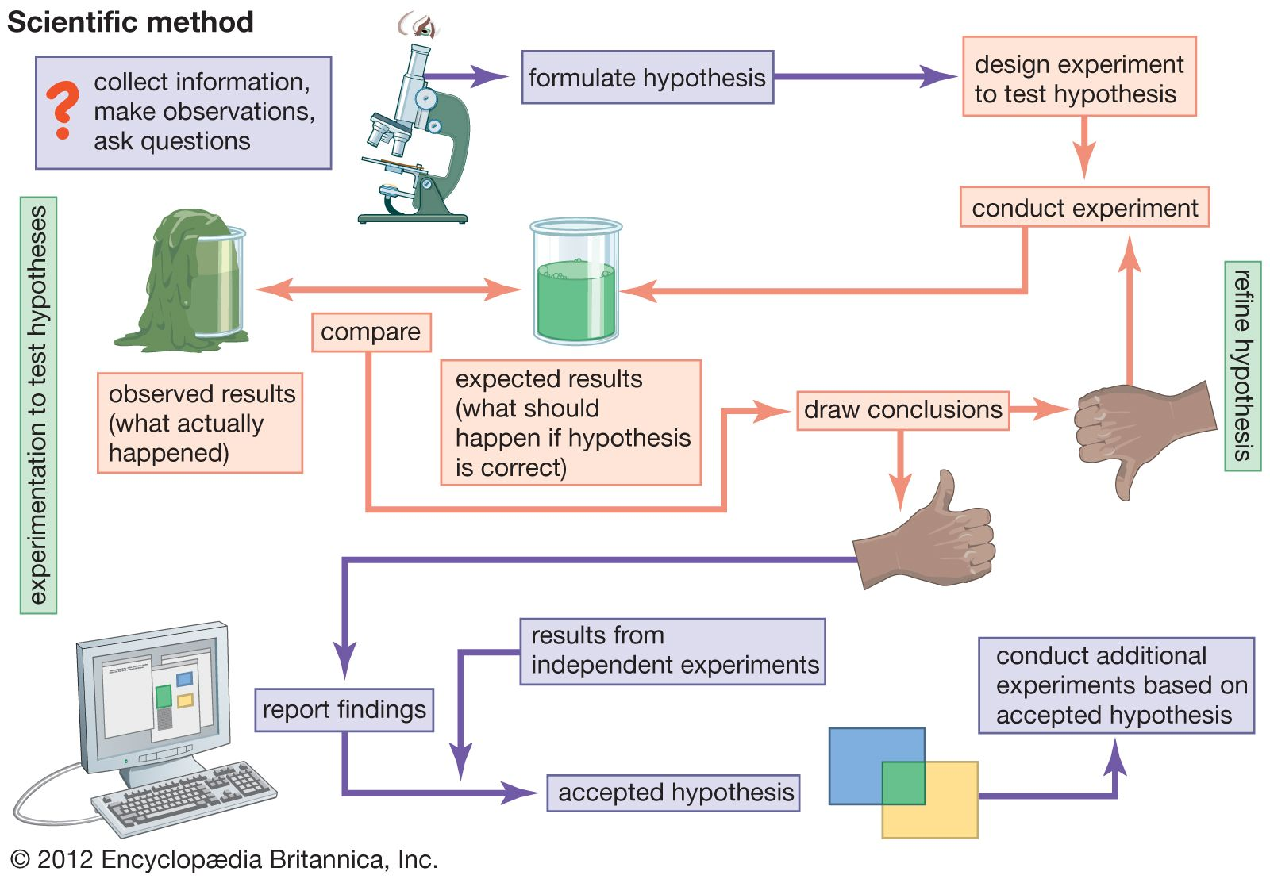

Slide 13
Some Considerations - Bias
Biases: are (sometimes) unintentional influences on the experimental results by the research
Confirmation
Selectively choosing data or results that support a preconceived conclusion
Sampling
Members of a population are more likely to be chosen over other samples
Survivorship
Researchers focus on members of a population that passed a selection process over others
Attrition
Some members of the population disappear over time

Slide 14
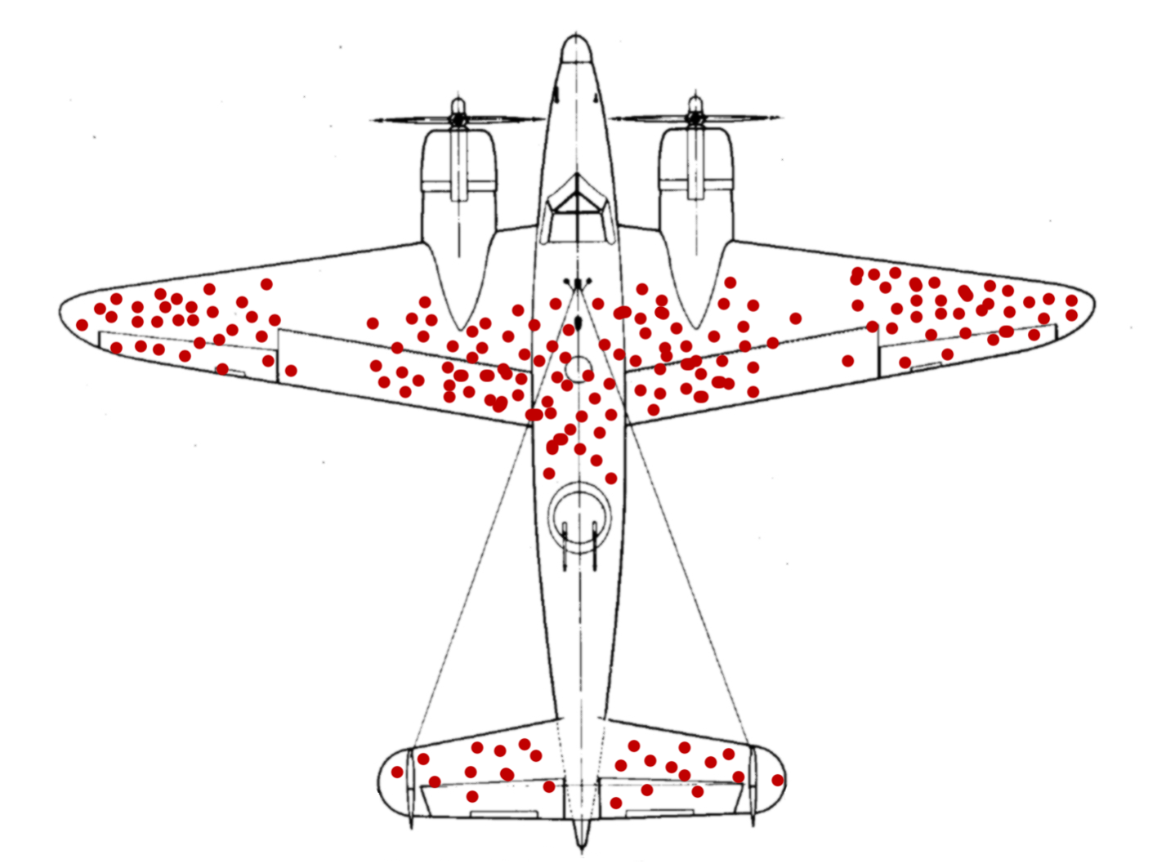
This Photo by Unknown Author is licensed under CC BY
Notes:
Aside: survivorship bias
In World War 2, allied bombers were being show down by the hundreds. An examination of surviving aircraft squadrons showed that most airplanes that made it back from their runs received hits to the areas marked in red. The allied engineers decided that in order to increase the survivability of their aircraft, they would need to up-armor the red portions of their planes, reducing their speed and payload capacity, but hopefully saving lives and planes. It did not work. Bomber kill rates did not decline and it was only after someone realized that none of the surviving aircraft had been hit in the middle of the wing spar or empennage that it was decided to up-armor those areas instead. This is literal survivorship bias as engineers favored the statistics of the surviving planes, without regarding the causes of the casualties.

Slide 15
Some Considerations - Errors
Errors: Are (mostly) unintentional mistakes made during the experiment
Blunders
Misreading labels, wrong measurement modes, wrong units, etc. Simple, but potentially devastating
Accidents
Mistakes that disrupt the test, losing track of variables, environmental conditions suddenly changed
Procedural
Not following the prescribed procedure exactly or consistently
Also, a big source of bias
Systemic
Measurement errors that consistently affect the values and, therefore accuracy, of the result
Random
Unpredictable deviations in the measurement values throughout the experiment affecting precision
Discussion: What are some possible errors you could encounter during your testing?

Slide 16
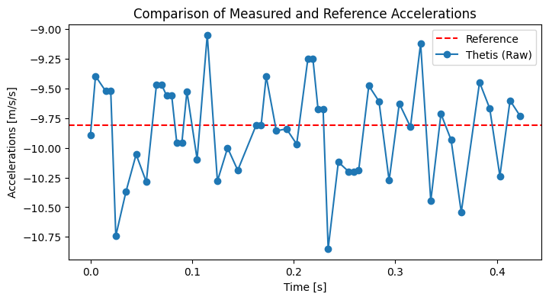
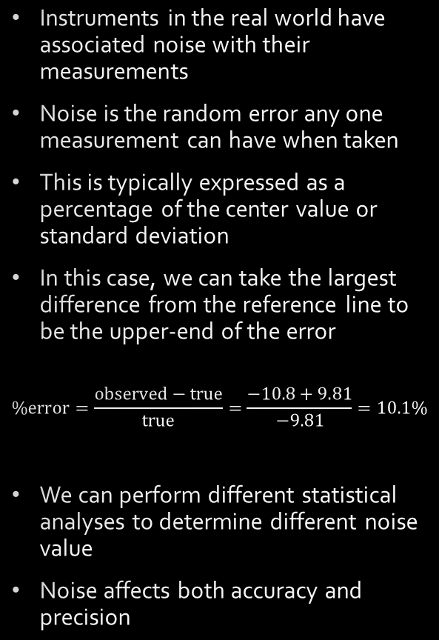
Process Noise
Instruments in the real world have associated noise with their measurements
Noise is the random error any one measurement can have when taken
This is typically expressed as a percentage of the center value or standard deviation
In this case, we can take the largest difference from the reference line to be the upper-end of the error
$$\%error=\frac{observed−true}{true}=\frac{−10.8+9.81}{−9.81}=10.1\%$$
We can perform different statistical analyses to determine different noise value
Noise affects both accuracy and precision

Slide 17
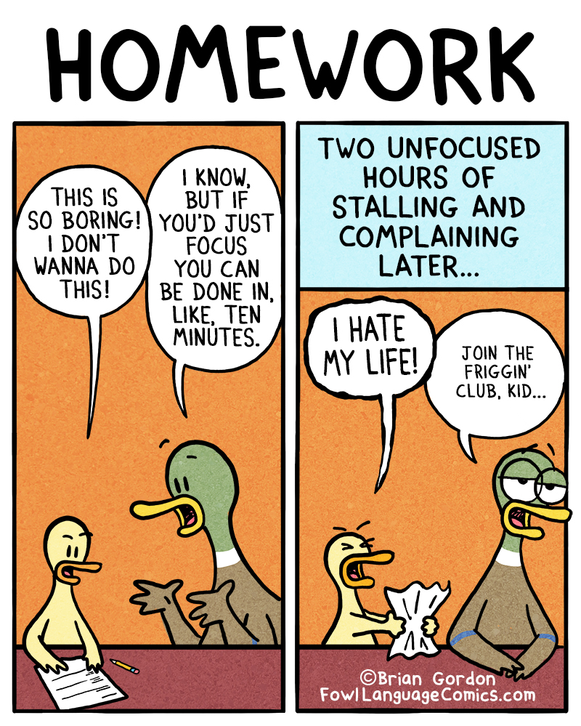
Dice Roll Programming Assignment
Friday, January 20

Slide 18

Questions?

